Slide 1
Artificial Intelligence

Slide 2
Lecture # 06
Informed Search

Slide 3
Outline
Informed Search
• Uninformed Versus Informed Search
• Greedy Best First Search
A* Search

Slide 4
Informed Search
Informed searches use domain knowledge to guide selection of the best path to continue searching
• Heuristics are used, which are informed guesses
• Heuristic means "serving to aid discovery“
• A heuristic is a function that estimates the cost of reaching a goal from a given state

Slide 5
Informed Search
Define a heuristic function on, h( n)
– uses domain-specific information in some way
– is computable from the current state description
– it estimates
• the "goodness" of node n
• how close node n is to a goal
• the cost of minimal cost path from node n to a goal state

Slide 6
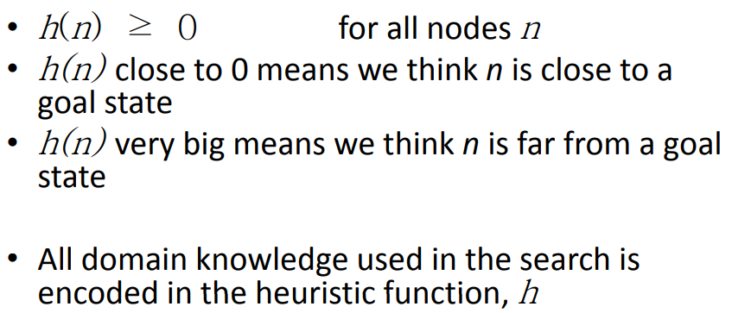
Informed Search

Slide 7
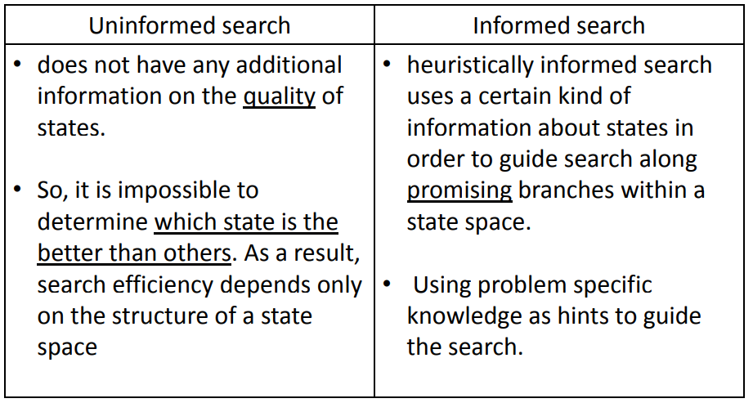
Informed vs Uninformed

Slide 8
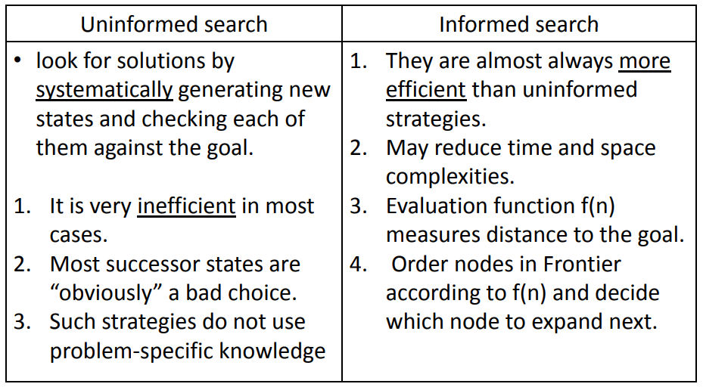
Informed vs Uninformed

Slide 9
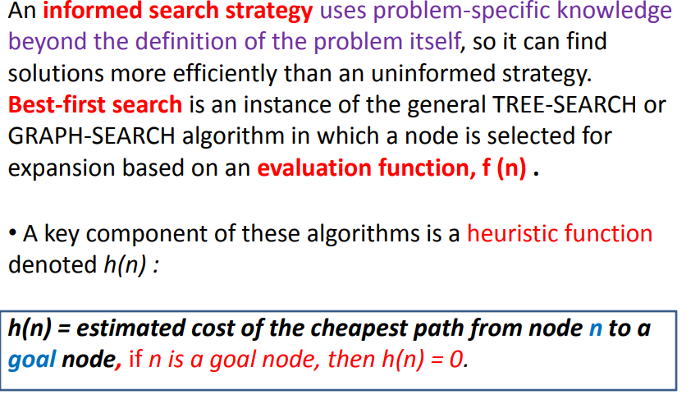
Best First Search

Slide 10
Best-First Search
Special cases:
•
Greedy Best first search
•
“Always chooses the successor node with
value” where f(n) = h(n)
the best f
•
We choose the one that is nearest to the final state
among all possible choices
•
A* search
•
Best first search using an “admissible” heuristic function
that takes into account the current cost g
f
•
Always returns the optimal solution path
9

Slide 11
Greedy Best First Search
eval-fn:
f(n)
=
h(n)

Slide 12
Greedy Best-First Search
•
Greedy best-first search tries to expand the node
that is closest to the goal, on the grounds that it is
likely to lead to a solution quickly.
Thus, it evaluates nodes by using just the heuristic
•
function; that is, f(n)=h(n).
Evaluation function
•
•
f(n) = h(n) (heuristic) = estimate of cost from n to goal
•
Assume hSLD(n) = straight line distance from n to
Bucharest,
so Greedy best-first search expands the
node that appears to be closest to goal
d h b l l
11

Slide 13




Map
of
Romania

Slide 14
Greedy
Search
Start
75
State
Heuristic: h(n)
A
A
366
118
140
B
B
374
C
C
111
D
C
329
E
80
99
D
244
E
253
G
F
F
178
97
G
193
H
101
211
H
98
I
0
I
Goal
f(n) = h (n) = straight-line distance heuristic

Slide 15
Greedy
Search
Start
75
State
Heuristic: h(n)
A
A
366
118
140
B
B
374
C
C
111
D
C
329
E
80
99
D
244
E
253
G
F
F
178
97
G
193
H
101
211
H
98
I
0
I
Goal
f(n) = h (n) = straight-line distance heuristic

Slide 16
Greedy
Search
Start
75
State
Heuristic: h(n)
A
A
366
118
140
B
B
374
C
C
111
D
C
329
E
80
99
D
244
E
253
G
F
F
178
97
G
193
H
101
211
H
98
I
0
I
Goal
f(n) = h (n) = straight-line distance heuristic

Slide 17
Greedy
Search
Start
75
State
Heuristic: h(n)
A
A
366
118
140
B
B
374
C
C
111
D
C
329
E
80
99
D
244
E
253
G
F
F
178
97
G
193
H
101
211
H
98
I
0
I
Goal
f(n) = h (n) = straight-line distance heuristic

Slide 18
Greedy
Search
Start
75
State
Heuristic: h(n)
A
A
366
118
140
B
B
374
C
C
111
D
C
329
E
80
99
D
244
E
253
G
F
F
178
97
G
193
H
101
211
H
98
I
0
I
Goal
f(n) = h (n) = straight-line distance heuristic
20

Slide 19
Greedy
Search
Start
75
State
Heuristic: h(n)
A
A
366
118
140
B
B
374
C
C
111
D
C
329
E
80
99
D
244
E
253
G
F
F
178
97
G
193
H
101
211
H
98
I
0
I
Goal
f(n) = h (n) = straight-line distance heuristic
21

Slide 20
Greedy
Search
Start
75
State
Heuristic: h(n)
A
A
366
118
140
B
B
374
C
C
111
D
C
329
E
80
99
D
244
E
253
G
F
F
178
97
G
193
H
101
211
H
98
I
0
I
Goal
f(n) = h (n) = straight-line distance heuristic
22

Slide 21
Greedy
Search
Start
75
State
Heuristic: h(n)
A
A
366
118
140
B
B
374
C
C
111
D
C
329
E
80
99
D
244
E
253
G
F
F
178
97
G
193
H
101
211
H
98
I
0
I
Goal
f(n) = h (n) = straight-line distance heuristic
23

Slide 22
Greedy
Search
Start
75
State
Heuristic: h(n)
A
A
366
118
140
B
B
374
C
C
111
D
C
329
E
80
99
D
244
E
253
G
F
F
178
97
G
193
H
101
211
H
98
I
0
I
Goal
f(n) = h (n) = straight-line distance heuristic
24

Slide 23
Greedy
Search
Start
75
State
Heuristic: h(n)
A
A
366
118
140
B
B
374
C
C
111
D
C
329
E
80
99
D
244
E
253
G
F
F
178
97
G
193
H
101
211
H
98
I
0
I
Goal
f(n) = h (n) = straight-line distance heuristic
25

Slide 24
Greedy
Search –
Tree
Search
Start
State
Heuristic
: h(n)
St t
A
A
366
B
374
C
329
D
244
E
253
F
178
G
193
H
98
I
0
26

Slide 25
Greedy Search –
Tree
Search
Start
State
Heuristic
: h(n)
St t
A
118
75
A
366
[329]
140
[374]
B
C
C
B
374
[253]
E
C
329
D
244
E
253
F
178
G
193
H
98
I
0
27

Slide 26
Greedy
Search
– Tree
Search
Start
State
Heuristic
: h(n)
St t
A
118
75
A
366
[329]
140
[374]
B
C
C
B
374
[253]
E
C
329
80
99
D
244
[193]
G
F
[178]
E
253
[366]
A
F
178
G
193
H
98
I
0
28

Slide 27
Greedy Search – Tree
Search
Start
State
Heuristic
: h(n)
St t
A
118
75
A
366
[329]
140
[374]
B
C
C
B
374
[253]
E
C
329
80
99
D
244
[193]
G
F
[178]
E
253
[366]
A
F
178
211
G
193
[253]
I
[0]
H
98
E
I
0
Goal
29

Slide 28
Greedy Search –
Tree
Search
Start
75
A
118
State
Heuristic
: h(n)
St t
[329]
140
[374]
B
C
E
A
366
[253]
80
99
B
374
C
329
[193]
G
F
[178]
A
D
244
A
[366]
211
E
253
F
178
[253]
I
[0]
I
E
G
193
Goal
H
98
Path cost(A-E-F-I) = 253 + 178 + 0 = 431
dist(A-E-F-I) = 140 + 99 + 211 = 450
I
0
E I) 253 + 178 + 0
30

Slide 29
Greedy
Search:
Optimal
?
State
Heuristic: h(n)
A
366
St t ^{A}
Start
A
B
374
118
75
B
C
329
C
140
C
111
D
D
244
E
E
253
80
99
F
178
G
F
G
193
97
H
98
H
I
0
211
101
f(n) = h (n) = straight-line distance heuristic
I
Goal
dist(A-E-G-H-I) = 140 + 80 + 97 + 101 = 418
31

Slide 30
Greedy
Search:
Complete
?
State
Heuristic:
h(n)
Start
A
118
75
A
366
140
B
B
374
C
C
111
D
** C
250
E
80
99
D
244
E
253
G
F
F
178
97
G
193
G
H
101
211
H
98
I
0
I
Goal
f(n) = h (n) = straight-line distance heuristic
32

Slide 31
Greedy
Search:
Tree
Search
State
Heuristic:
h(n)
Start
A
A
366
B
374
** C
250
D
244
E
253
F
178
G
193
G
H
98
I
0
33

Slide 32
Greedy
Search:
Tree
Search
State
Heuristic:
h(n)
Start
A
118
75
A
366
[250]
140
[374]
B
B
374
C
C
** C
250
[253]
E
D
244
E
253
F
178
G
193
G
H
98
I
0
34

Slide 33
Greedy
Search:
Tree
Search
State
Heuristic:
h(n)
Start
A
118
75
A
366
[250]
140
[374]
B
B
374
C
C
** C
250
[253]
E
111
[244]
D
244
^{[244]} D
D
E
253
F
178
G
193
G
H
98
I
0
35

Slide 34
Greedy
Search:
Tree
Search
State
Heuristic:
h(n)
Start
A
118
75
A
366
[250]
140
[374]
B
B
374
C
C
** C
250
[253]
E
111
[244]
D
244
^{[244]} D
D
E
253
Infinite Branch !
F
178
[250]
C
G
193
C G
H
98
I
0
36

Slide 35
Greedy
Search:
Tree
Search
State
Heuristic:
h(n)
Start
A
118
75
A
366
[250]
140
[374]
B
B
374
C
C
** C
250
[253]
E
111
[244]
D
244
^{[244]} D
D
E
253
Infinite Branch !
F
178
[250]
C
G
193
C G
H
98
I
0
[244]
D
37

Slide 36
Greedy
Search:
Tree
Search
State
Heuristic:
h(n)
Start
A
118
75
A
366
[250]
140
[374]
B
B
374
C
C
** C
250
[253]
E
111
[244]
D
244
^{[244]} D
D
E
253
Infinite Branch !
F
178
[250]
C
G
193
C G
H
98
I
0
[244]
D
38

Slide 37
Greedy
Search: Time and Space Complexity
• Greedy search is not optimal.
?
Start
A
75
• Greedy search is incomplete
without systematic checking of
118
140
B
C
C
111
D
repeated states.
• In the worst case, the Time and
E
80
99
G
F
Space Complexity of Greedy
Search are both O(b^{m})
97
H
101
211
Where b is the branching factor and m the maximum
path length
I
Goal
39

Slide 38
A* Search
eval-fn:
f(n)
=
g(n)
+
h(n)
40

Slide 39
A
(A Star)
* (A Star)
o Greedy Search minimizes a heuristic h(n) which is an
estimated cost from a node n to
he goal state. Greedy
estimated cost from a node n to the goal state Greedy
Search is efficient but it is not optimal nor complete.
o Uniform Cost Search minimizes the cost g(n) from the
initial state to n. UCS is optimal and complete but
efficient.
not
o New Strategy:
Combine Greedy Search and UCS
to
S
get an efficient
optimal.
algorithm which is complete and
41

Slide 40
A
(A Star)
* (A Star)
• A* uses a heuristic function which combines
g(n) and h(n): f(n) = g(n) + h(n)
• g(n) is the exact cost to reach node n from
the initial state.
• h(n) is an estimation of the remaining cost
to reach the goal.
42

Slide 41
A
(A
Star)
* (A Star)
g(n)
f(n) = g(n)+h(n)
n
h(n)
43

Slide 42
A*
Search
State
Heuristic: h(n)
A
366
St t ^{A}
Start
A
75
B
374
118
B
C
329
C
140
C
111
D
D
244
E
E
253
80
99
F
178
F
G
F
G
193
97
H
98
H
101
I
0
211
f(n) = g(n) + h (n)
I
g(n): is the exact cost to reach node n from the initial state.
Goal
44

Slide 43
A*
Search: Tree
Search
Start
State
Heuristic:
h(n)
A
A
366
B
374
C
329
D
244
E
253
F
178
G
193
H
98
I
0
I
45

Slide 44
A*
Search:
Tree
Search
Start
State
Heuristic:
h(n)
A
118
75
A
366
140
[393]
B
374
E
B
[449]
[447]
C
C
329
D
244
E
253
F
178
G
193
H
98
I
0
I
C= g(n)+h(n) => 118+329=447
E= g(n)+h(n) => 140+253=393
B= g(n)+h(n) => 75+374=449
46
Notes:
B= 75+374=449

Slide 45
A*
Search: Tree
Search
Start
State
Heuristic:
h(n)
A
118
75
A
366
140
B
374
E
[393]
99
B
[449]
[447]
C
C
329
80
D
244
[413]
G
F
[417]
E
253
F
178
G
193
H
98
I
0
I
F= g(n)+h(n)=> [(140+99)+178]=417
G= g(n)+h(n)=> 140+80+193=413
47

Slide 46
A*
Search: Tree
Search
Start
Stat e
Heuristic:
h(n)
A
118
75
A
366
140
B
374
E
[393]
99
B
[449]
[447]
C
C
329
80
D
244
[413]
G
F
[417]
E
253
97
F
178
[415]
H
G
193
H
98
I
0
H= 140+80+97+98=415
48
Notes:
H= 140+80+97+98=415

Slide 47
A*
Search:
Tree
Search
Start
State
Heuristic:
h(n)
A
118
75
A
366
140
B
374
E
[393]
99
B
[449]
[447]
C
C
329
80
D
244
[413]
G
F
[417]
E
253
97
F
178
[415]
H
G
193
H
98
101
I
0
I
Goal
I
[418]
49

Slide 48
A*
Search:
Tree
Search
Start
State
Heuristic:
h(n)
A
118
75
A
366
140
B
374
E
[393]
99
B
[449]
[447]
C
C
329
80
D
244
[413]
G
F
[417]
211
E
253
97
F
178
[415]
H
I
[450]
G
193
H
98
101
I
0
I
Goal
I
[418]
50

Slide 49
A*
Search:
Tree
Search
Start
State
Heuristic:
h(n)
A
118
75
A
366
140
B
374
E
[393]
99
B
[449]
[447]
C
C
329
80
D
244
[413]
G
F
[417]
211
E
253
97
F
178
[415]
H
I
[450]
G
193
H
98
101
I
0
I
Goal
I
[418]
51

Slide 50
A*
Search:
Tree
Search
Start
State
Heuristic:
h(n)
A
118
75
A
366
140
B
374
E
[393]
99
B
[449]
[447]
C
C
329
80
D
244
[413]
G
F
[417]
211
E
253
97
F
178
[415]
H
I
[450]
G
193
H
98
101
I
0
I
Goal
I
[418]
52

Slide 51
A* with f() not Admissible
h()
overestimates
the
cost
to
reach
the
goal
state
a heuristic function is said to be admissible if it never overestimates the cost of reaching the goal, i.e. the cost it estimates to reach the goal is not higher than the lowest possible cost from the current point in the path
53

Slide 52
A* Search:
Start
h
not
admissible
!
State
Heuristic: h(n)
A
75
A
366
118
B
374
140
B
C
C
329
111
D
E
E
D
244
80
99
E
253
G
F
F
178
F F
97
H
101
G
193
H
138
211
211
I
0
I
f(n) = g(n) + h (n) – (H-I) Overestimated
g(n): is the exact cost to reach node n from the initial state.
Goal
54

Slide 53
A*
Search: Tree
Search
A
Start
55

Slide 54
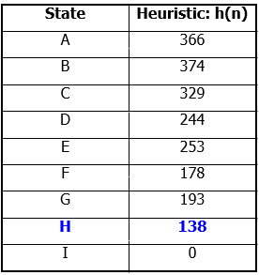
A*
Search:
Tree
Search
A
Start
118
75
140
E
[393]
B
[449]
[447]
C
56

Slide 55
A*
Search:
Tree
Search
A
Start
118
75
140
E
[393]
99
B
[449]
[447]
C
80
[413]
G
F
[417]
57

Slide 56
A*
Search:
Tree
Search
A
Start
118
75
140
E
[393]
99
B
[449]
[447]
C
80
[413]
G
F
[417]
97
[455]
H
58

Slide 57
A*
Search:
Tree
Search
A
Start
118
75
140
E
[393]
99
B
[449]
[447]
C
80
[413]
G
F
[417]
97
[455]
H
Goal
I
[450]
59

Slide 58
A*
Search:
Tree
Search
A
Start
118
75
140
C
E
[393]
99
B
[449]
[447]
80
[473]
D
[413]
G
F
[417]
211
97
[455]
H
Goal
I
[450]
60

Slide 59
A*
Search:
Tree
Search
A
Start
118
75
140
C
E
[393]
99
B
[449]
[447]
80
[473]
D
[413]
G
F
[417]
211
97
[455]
H
Goal
I
[450]
61

Slide 60
A*
Search:
Tree
Search
A
Start
118
75
140
C
E
[393]
99
B
[449]
[447]
80
[473]
D
[413]
G
F
[417]
211
97
[455]
H
Goal
I
[450]
62

Slide 61
A*
Search:
Tree
Search
A
Start
118
75
140
E
[393]
99
B
[449]
[447]
C
80
[473]
D
[413]
G
F
[417]
211
97
[455]
H
Goal
I
[450]
A* not optimal !!!
A* not optimal !!!
63

Slide 62
A* Search
A* with systematic checking
for
repeated
states
…
64

Slide 63
A
Algorithm
* Algorithm
1.
2.
3.
4.
Search queue Q is empty.
Place the start state s in Q with f value h(s).
If Q is empty, return failure.
Take node n from Q with lowest f value.
(Keep Q sorted by f values and pick the first element).
If n is a goal node, stop and return solution.
Generate successors of node n.
For each successor n’ of n do:
a) Compute f(n’) = g(n) + cost(n,n’) + h(n’).
b) If n’ is new (never generated before), add n’ to Q.
c) If node n is already in Q with a higher f value, replace it with current f(n’) and place it in sorted order in Q.
End for
Go back to step 3.
5.
6.
7.
c) If node n’
8.
65

Slide 64
A*
Search: Analysis
•A* is complete except if there is an
Start
A
75
infinity of nodes with f < f(G).
•A* is optimal if heuristic h is
118
140
B
C
C
111
D
admissible. (underestimated)
•Time complexity depends on the
E
80
99
quality of heuristic but is still
exponential.
•For space complexity, A* keeps all
G
F
97
H
101
211
nodes in memory. A* has worst case
O(b^{d}) space complexity, but an iterative
I
deepening version is possible (IDA*).
Goal
66

Slide 65
Conclusions
Frustration with uninformed search led to the
•
idea
of using
domain
specific
knowledge
in
a
id i ifi i
search
so
that
one
can
intelligently
explore
only the relevant part of the search space that
has a good chance of containing the goal state.
only relevant of search that
These
new
techniques
are
called
informed
(heuristic) search strategies.
•
Even
though
heuristics
improve
the
performance of
informed
search
algorithms,
they
large
are
size
still
time
consuming
especially
for
instances.
67

